Slide 1
أكـــــاديميــــة طــــويـــق
Scalable Data Science

Slide 2
Data visualization
With Seaborn and Matplotlib
By: Dr. Afshan Hashmi

Slide 3
Course Objectives:
Learn the fundamentals of data visualization using Matplotlib and Seaborn.
Create static, animated, and interactive plots for data analysis.
Utilize Seaborn for statistical and enhanced visualizations.
Customize plots with themes, colors, and annotations.

Slide 4
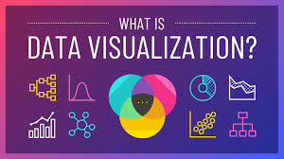
Matplotlib and Seaborn for Data Visualization
Data visualization is crucial in scalable data science for understanding trends, distributions, and relationships.
Matplotliband Seaborn are two powerful Python libraries that provide extensive functionalities for creating insightful and high-quality visualizations.

Slide 5
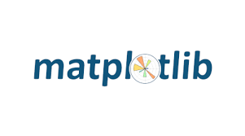
Matplotlib
Introduction to Matplotlib: Matplotlib is a fundamental library for creating static, animated, and interactive visualizations. It provides fine-grained control over plots, making it highly customizable.
Key Features:
Supports a wide range of plot types (line, bar, scatter, etc.).
Highly customizable (labels, colors, themes, annotations).
Integrates well with Jupyter Notebooks and other Python libraries.

Slide 6
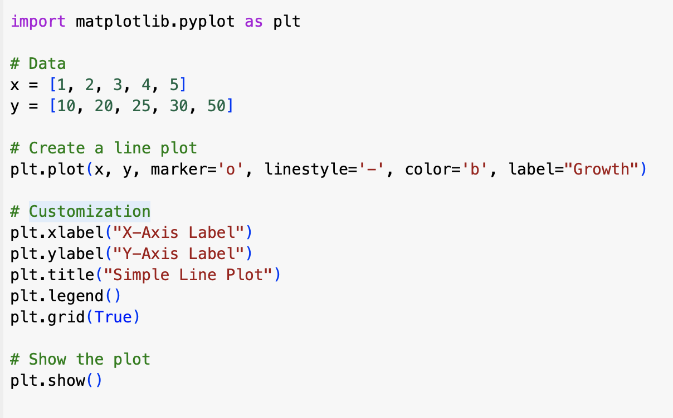
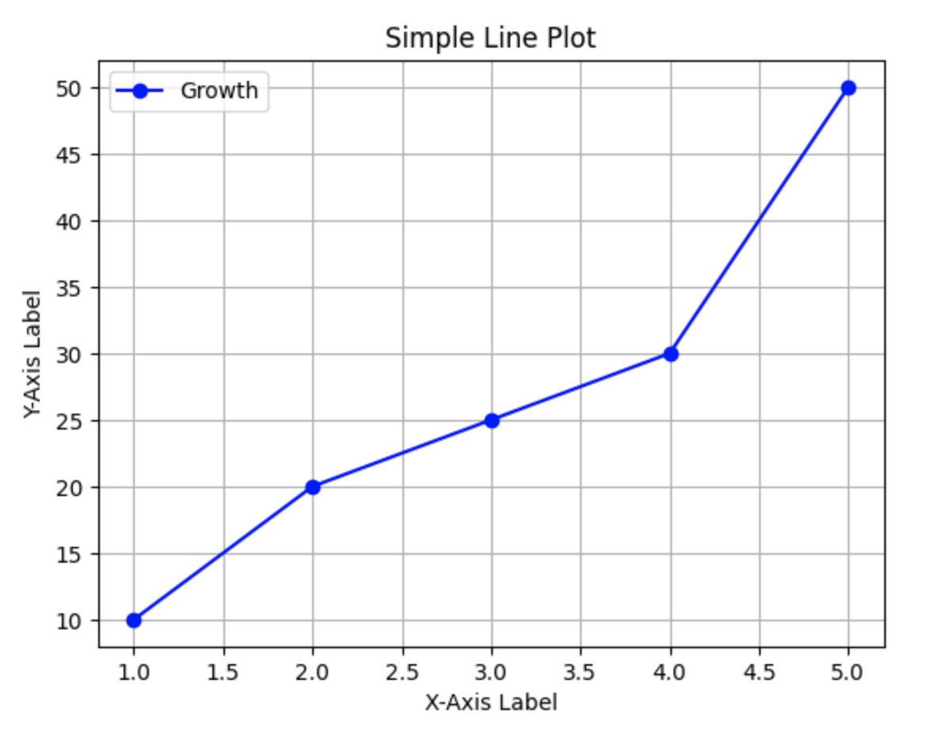
Using Matplotlib

Slide 7

Seaborn
Creating Plots with Seaborn
Purpose: Seaborn is built on top of Matplotlib and provides a high-level interface for creating advanced statistical plots.
Key Features:
Simplifies the creation of complex visualizations (e.g., heatmaps, pair plots).
Enhances Matplotlib graphs with better default styles and color palettes.

Slide 8
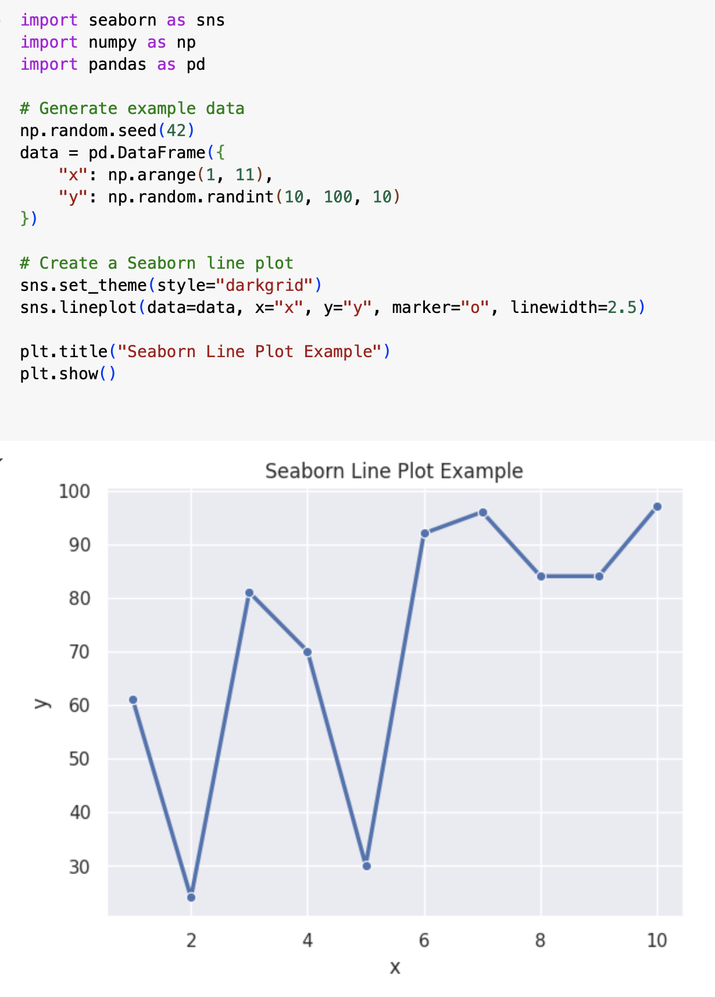
Using Seaborn

Slide 9
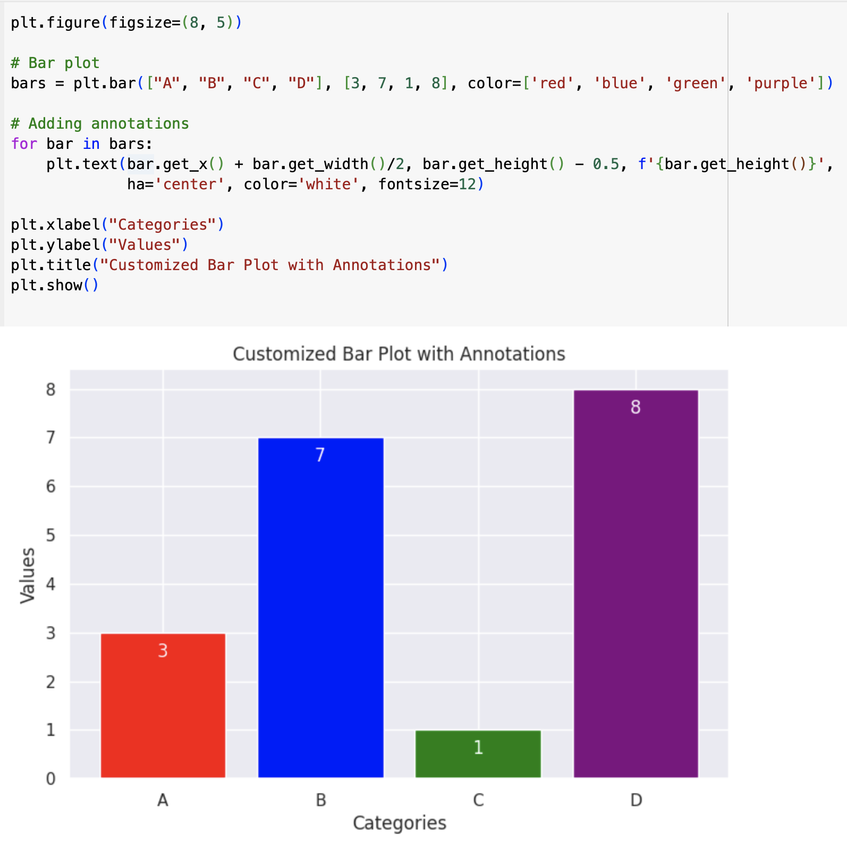
Customizing Visuals
Customizing plots makes them more readable and visually appealing. You can modify labels, colors, themes, and annotations in both Matplotlib and Seaborn.

Slide 10
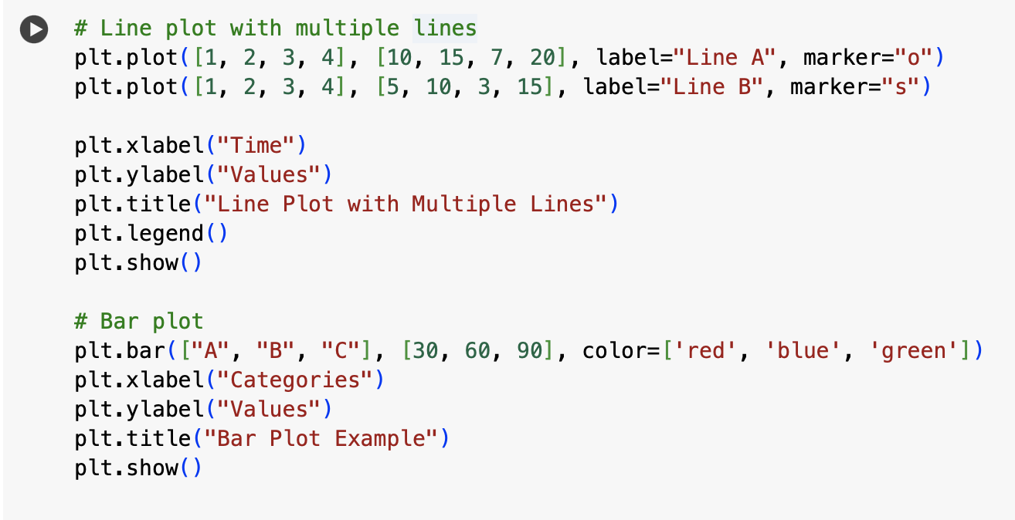
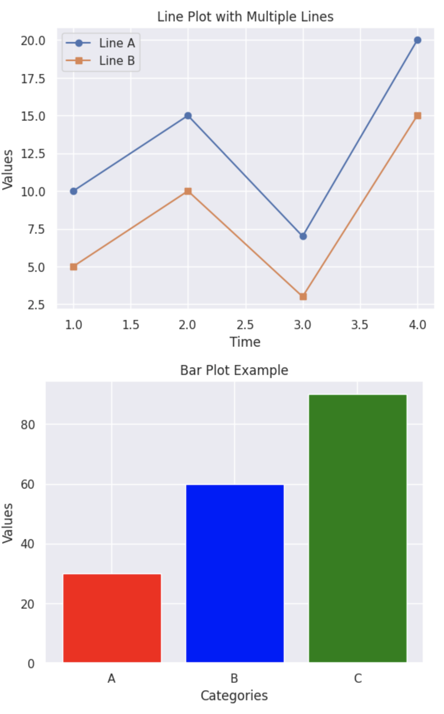
Line and Bar Plots
Used to visualize trends over time and compare categorical data.

Slide 11
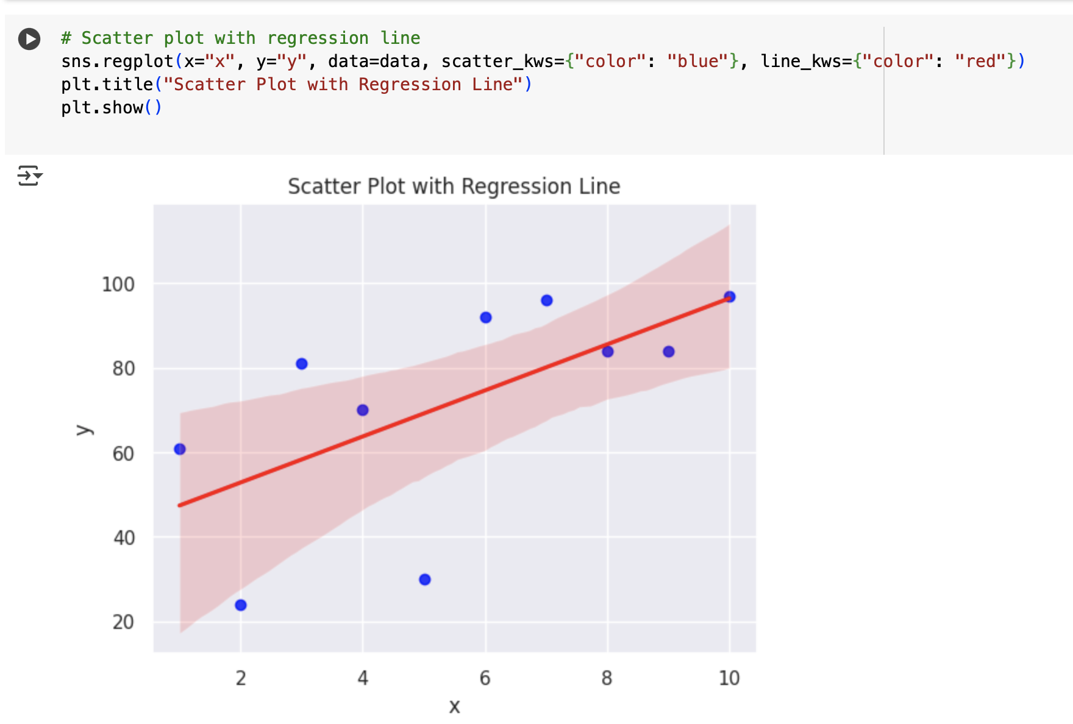
Scatter and Box Plots
Scatter plots show relationships between two variables.
Example: Scatter Plot with Regression Line

Slide 12
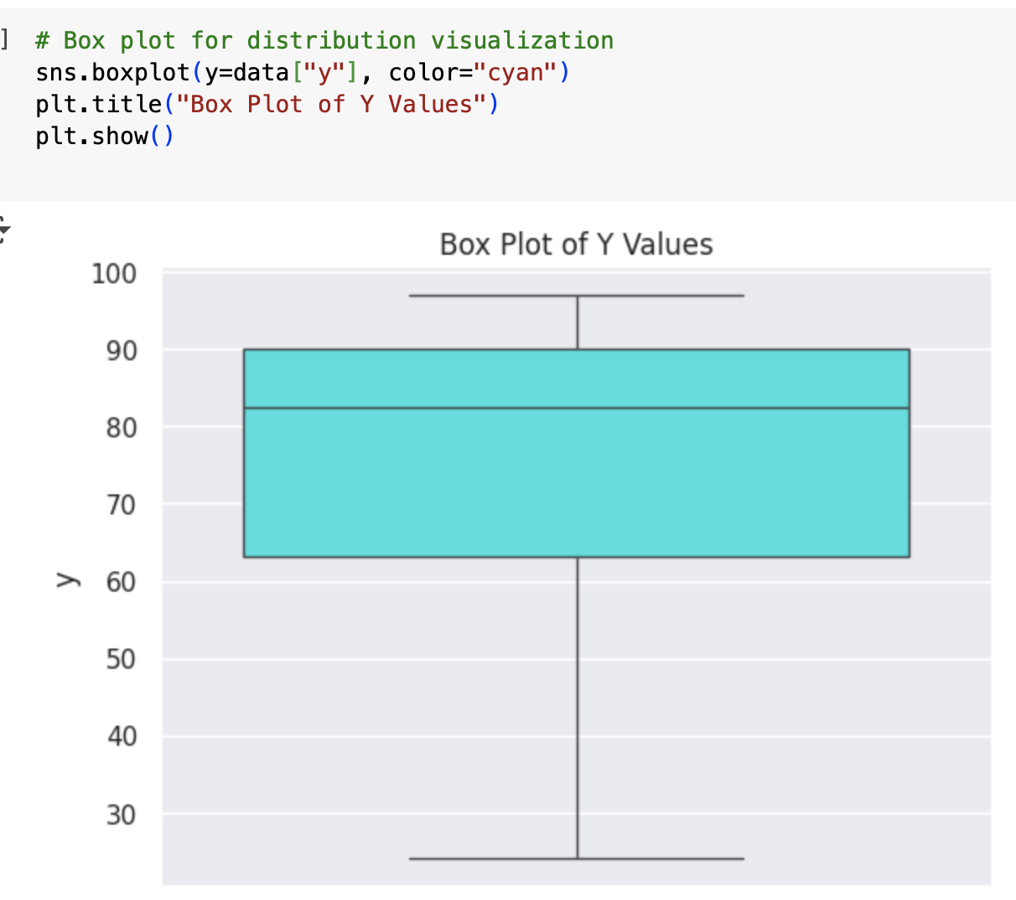
Box Plots
Box plots help analyze the distribution and outliers in a dataset.

Slide 13

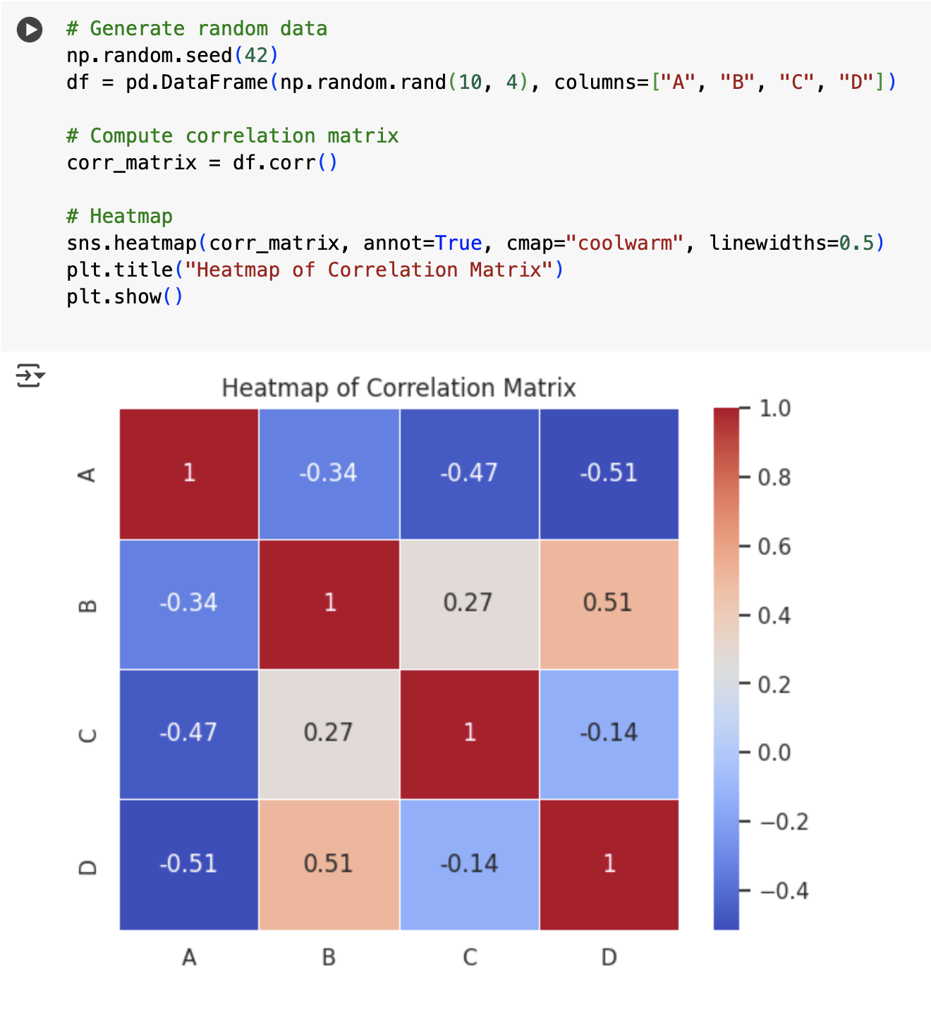
Heatmaps visualize correlations in datasets.

Slide 14
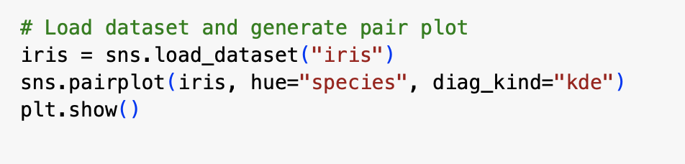
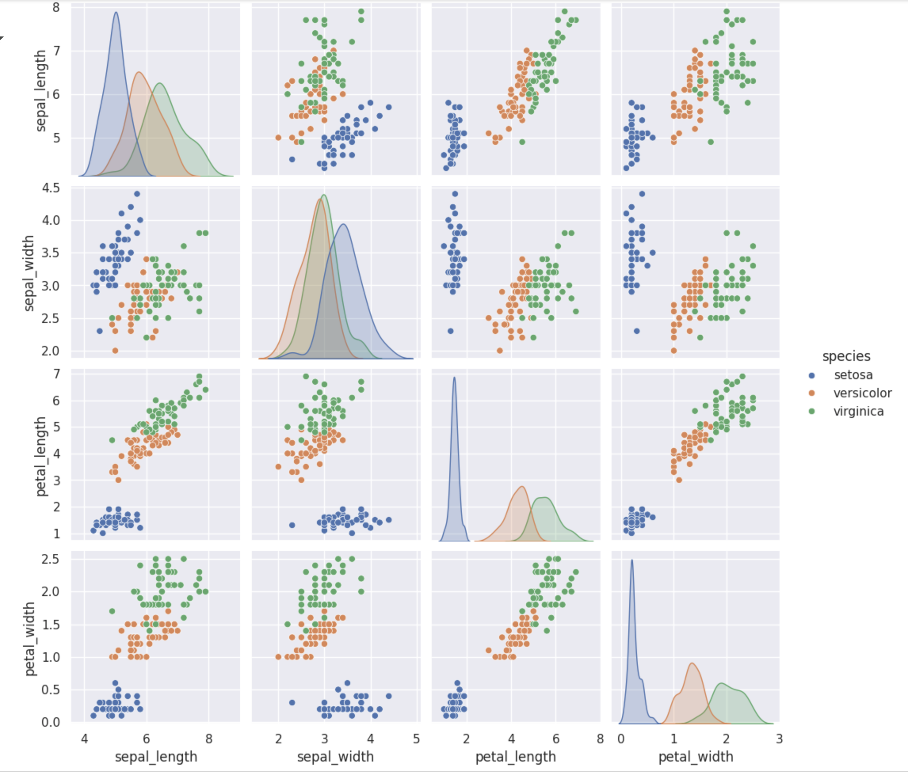
Pair plots show pairwise relationships in multi-variable data.

Slide 15
Conclusion
Matplotlib is great for fine-grained control over plots.
Seaborn simplifies statistical visualizations with beautiful themes.
Customization improves readability and storytelling in data science.
Different visualization types (scatter, box, heatmaps) provide insights into trends, distributions, and relationships.
These techniques are scalable, meaning they work efficiently with both small and large datasets.

Slide 16

Practical Implementation
Click on the link below to go to Google COLAB
https://colab.research.google.com/drive/1Z9sV8qnk7--__x8OcKO1adtFJz82f4Bx

Slide 17
شــــــكــــرًا لكــــــم
THANK YOU

